Slide 1

Book Review: The Last Orphans
Author: N. W. Harris
By: Kendralyn Burr

Slide 2
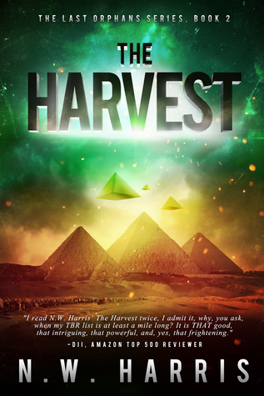

Review:
The Last Orphans, written be N. W. Harris is the first book in the series. This captivating sci-fi story takes place in a small town in Georgia. Suddenly, the adults of this small town all die, leaving the children alone, fighting to survive. Shane Tucker, along with other teens in the town take responsibility for 70 younger kids. This group of survivors face criminals, hardships, and weapon threatening to end all of humanity. This book is very entertaining and incites readers to continue reading the series.
This book and series are recommended for teens and adults that are interested in apocalyptic stories. It is also recommended for the young adult sections of all public libraries.
The Last Orphans was published October 9, 2014 by Clean Teen Publishing. The Kindle Edition has 263 pages and is free to download. The paperback version is available for $11.95 on Amazon.

